Slide 1
Iedereen Mobiel
La mobilité pour tous !

Slide 2
About Mobiel 21
A MENTAL & MODAL SHIFT FOR ALL
inspiring people to choose for sustainable mobility
accessible, ecological, affordable, safe and fair
in your street and on a EU level

Slide 3
Iedereen Mobiel
2 cycling parts in Flanders:
Start to cycle - lessons
Adapted bikes for less mobile persons
including exchange & coaching with Walloon partners

Slide 4
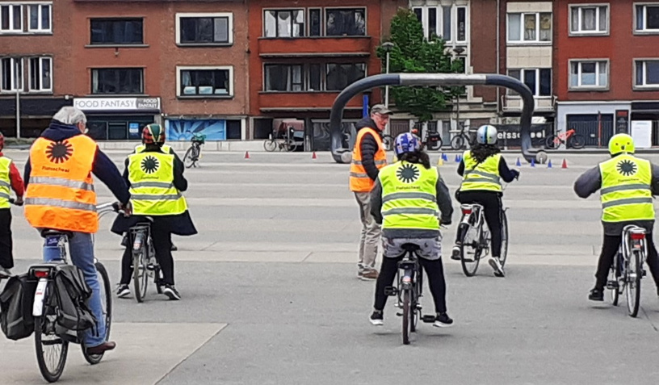
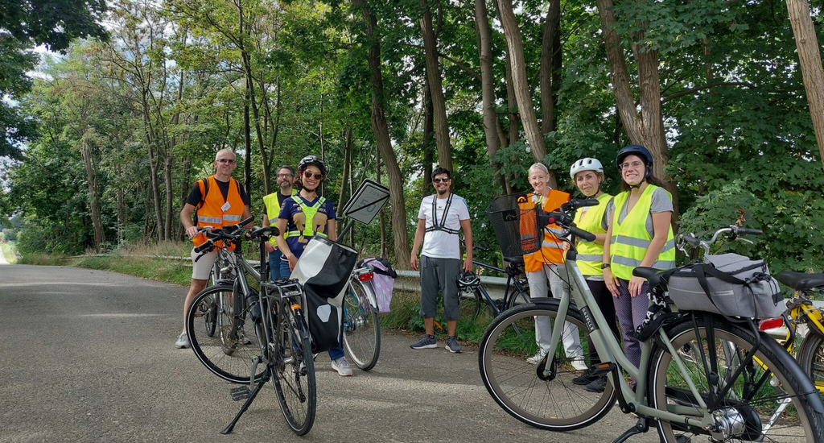
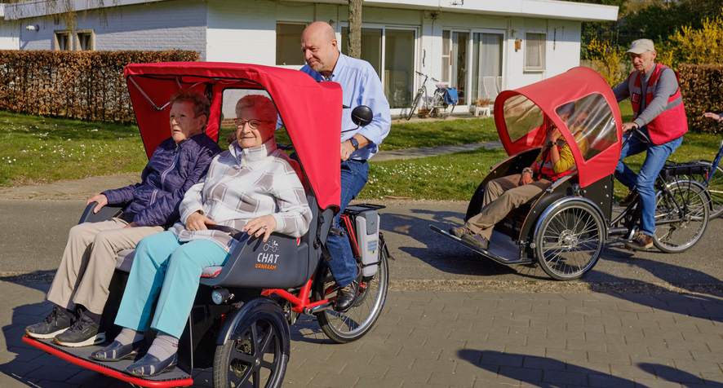
Flanders
CYCLING SCHOOL
AARSCHOT
ADAPTED BIKES
CYCLING WITHOUT AGE
Partner: Sociaal Huis
15 cycling lessons - 17 participants
purchase 10 lesson bikes
5 trained volunteers
Result: cycling lessons every 2 year
Zoutleeuw (2) - duobike + wheelchair transporter bike
Hoegaarden - wheelchair transporter bike + duobike
Diest - wheelchair bike

Slide 5
Cycling School Aarschot

Slide 6
Adapted bikes - Zoutleeuw
Partners
3 elderly homes
1 living unit for people with specific needs
City of Zoutleeuw
Results
Trained staff & family members
Shared bike system
Shared registration system
Maintenance and assurance by the City of Zoutleeuw
1 guideline How to ride a duobike?

Slide 7
Adapted bikes - Hoegaarden
Partners
1 elderly home
Results
Trained staff
implemented in daily routine activities and wellbeing of elderly
1 guideline How to ride a wheelchair transporter bike?

Slide 8
Adapted bikes - Diest
Partners
1 elderly home
Results
1 trained fysio therapist
implemented in daily routine activities and wellbeing of elderly
1 guideline How to ride a wheelchair bike?

Slide 9
Inspiration Day
Programme
Good examples
Project results
Testing
Results
25 participants
Press
Cycling fun!

Slide 10
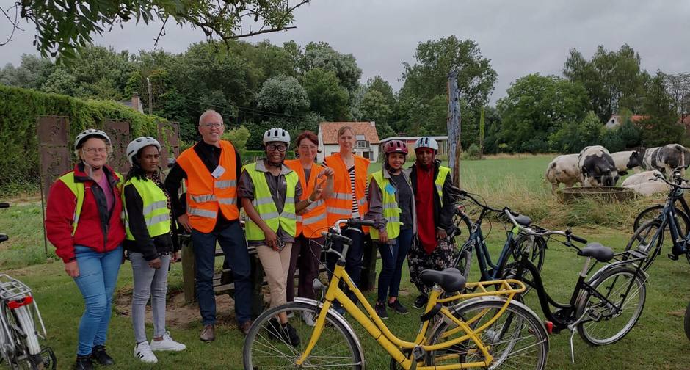
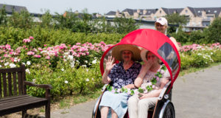
Exchange & coaching
CYCLING SCHOOL
JE PÉDALE POUR MA FORME
ADAPTED BIKES
Coaching start-up
Train-the-trainer
New chapters
Coaching start-up
Train-the-trainer
Cycling lessons
Training & webinars

Slide 11
Train-the-trainer in Rendeux
at Red Cross refugee center
focus on trafic rules for cyclists

Slide 12
Train-the-trainer in Leuven
Coaching start-up
Cycling training
For 5 LAG’s

Slide 13
Moments de mobilité douce
Testing: 1 rickshaw for 10 CPAS during 1 month
Workshop for pilots (10 people)
Inspiring movie

Slide 14
Iedereen Mobiel
Impact
A lot of cycling happiness
In rural regions
Extra asset in Covid period
Power of volunteers
Exchange is empowering & inspiring

Slide 15
Join us!
MOBIEL 21
DE FIETSSCHOOL
FIETSEN ZONDER LEEFTIJD
www.mobiel21.be
info@mobiel21.be
tel: +32 (0)16 23 94 65
www.defietsschool.be
fietsschoolleuven@mobiel21.be
www.fietsenzonderleeftijd.be
fietsenzonderleeftijd@mobiel21.be

